Slide 1
Data Visualization Methods for Scientific Careers
Kyeongan (Karl) Kwon
PhD Proposal
Advisor: Prof. Ioannis Pavlidis
Jan 2016
Notes:
Good morning everyone, Thank you for coming today for my PhD proposal. My name is Kyeongan and I go by Karl. Today, I am going to present my research about ‘data visualization methods for scientific careers’

Slide 2
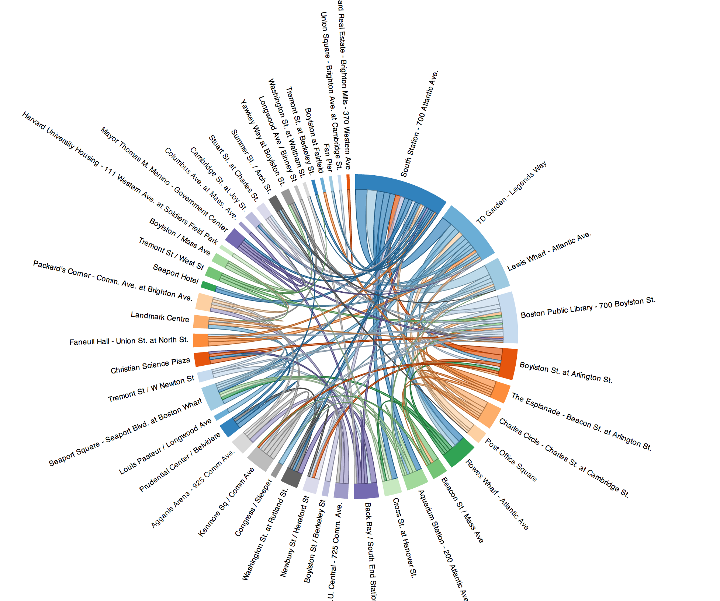
What is Data Visualization
“Data visualization is the graphical display of abstract information for two purposes: data analysis and communication. "
- Stephen Few
https://www.interaction-design.org/literature/book/the-encyclopedia-of-human-computer-interaction-2nd-ed/data-visualization-for-human-perception
Notes:
Before start to present my research, I would like to talk about a little bit what data visualization is exactly.
Data visualization is the graphical display of abstract information for two purposes: sense-making (also called data analysis) and communication.
visual face.

Slide 3
Why Data Visualization Matters?
Visualization makes data accessible
Quickly notice something out of position, patterns and pattern violations(trends, gaps, outliers)
Visualization gives faster access to actionable insights
Visualization allows access to huge amounts of data
https://www.youtube.com/watch?v=R-oiKt7bUU8

Slide 4
Data Visualizations vs. Infographics
Data Visualizations are generated by software.
Infographics are manually drawn.
http://www.tableau.com/about/blog/2012/04/guest-post-future-data-visualization-16578
http://www.heart.org/HEARTORG/GettingHealthy/HealthierKids/ChildhoodObesity/Obesity-in-Infants-and-Preschoolers-Infographic_UCM_467593_SubHomePage.jsp
Notes:
I would like to point out the difference between Data visualization and Infographics because many people are confused these two terms. Data Visualizations are far more likely to be generated automatically through the use of algorithms or computer programs. Infographics are manually drawn by Designers.

Slide 5
Exploration vs Explanation
Visualization for exploration, When you don’ts (yet) have a story to tell.
Visualization for explanation, when you have a story to tell.

Slide 6
Education vs Persuasion

Slide 7
Overview
Introduction
Topic and Purpose
Potential Significance
Related Research
Design and Methodology
Data Collection Methodology
System Architecture
Name Disambiguation
Live Demo
Research Challenges
Different types of data, different formats, different resources
No APIs provided (Google Scholar)
References
Future Work
Acknowledgment

Slide 8
Introduction
Motivation
Prior works
What is the problem I am studying?
Why is it important?
What results have you achieved?

Slide 9
Figures:
ER diagram – reverse engineer on WorkBench
PiWiki - Log
Visualization and Quantitative Analysis for subject and academic careers.
Justification : Usefulness,

Slide 10
(Topic and )Purpose
The best data visualizations are ones that expose something new about the underlying patterns and relationships contained within the data.
Something new: Scholar Plot / Scholar Compare / Group Plot

Slide 11
Visualization Research
How does it work usually?
Understanding data sources can help.
Where data come from
Put successful story
74% improved accuracy and performance

Slide 12
Data format and Data retrieval
JSON format and how to draw it in d3
Scholar Python
HtmlSQL in PHP
Computational representation – how good/ why it is good

Slide 13
Goals of Research, Motivation
Understand how people use visualizations to gain insight
Design principles and techniques for effective visual analysis systems
Visualizations techniques
Visualizations tools

Slide 14
Potential significance
Potential Significance

Slide 15
Related research
Scholar Plot^{R} (http://csullender.com/scholar/)
ScholarPlot python
Compare other research weakness
Notes:
We updated it based on what we wrote.

Slide 16
Design and Methodology
Justify design
Elements
Software architecture
Notes:
I would like to discuss the design and methodology of scholar plot.

Slide 17
Design and Methodology
Citation
Impact Factor
h-Index
Notes:
I have three figures of the same scholar in order to see the difference.
Google Scholar Profile. It is the most inclusively data
Curriculum Vitae, a brief account of a person's education, qualifications, and previous experience. It is still very popular. However, user needs to make themselves as PDF and always need to update it whenever new publications apperared.
Here, I want to ask you what these are missing?
- One when is the first and least publication they are publicshed.
– Another is you have no idea that
Quick comparison Google Scholar, Curriculum Vitae and SP
scientfic evidenace / crucial factors / justify why it is being considered.

Slide 18
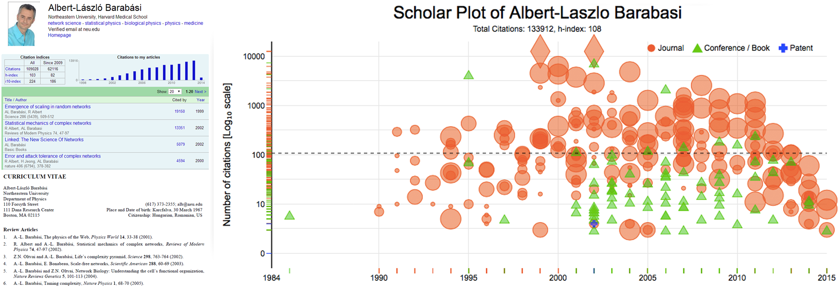
Design and Methodology
A: Google Scholar Profile
C. Scholar Plot
B: Curriculum Vitae
Notes:
I have three figures of the same scholar in order to see the difference.
Google Scholar Profile. It is the most inclusively data
Curriculum Vitae, a brief account of a person's education, qualifications, and previous experience. It is still very popular. However, user needs to make themselves as PDF and always need to update it whenever new publications apperared.
Here, I want to ask you what these are missing?
- One when is the first and least publication they are publicshed.
– Another is you have no idea that
Quick comparison Google Scholar, Curriculum Vitae and SP
scientfic evidenace / crucial factors / justify why it is being considered.

Slide 19
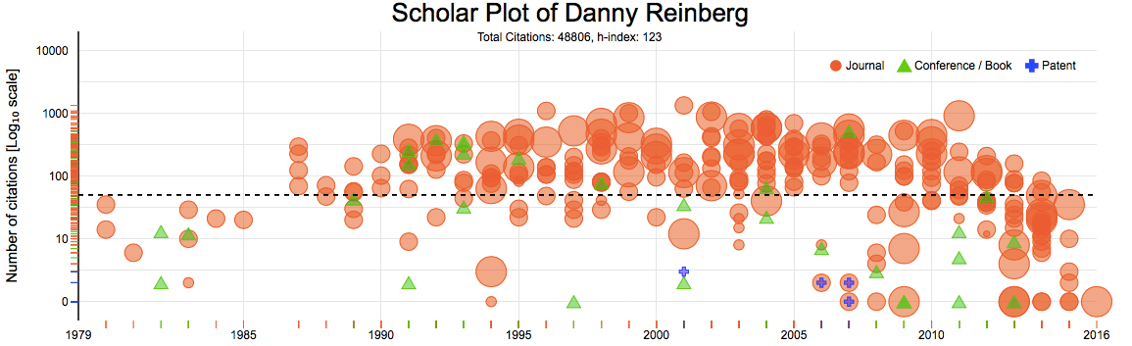
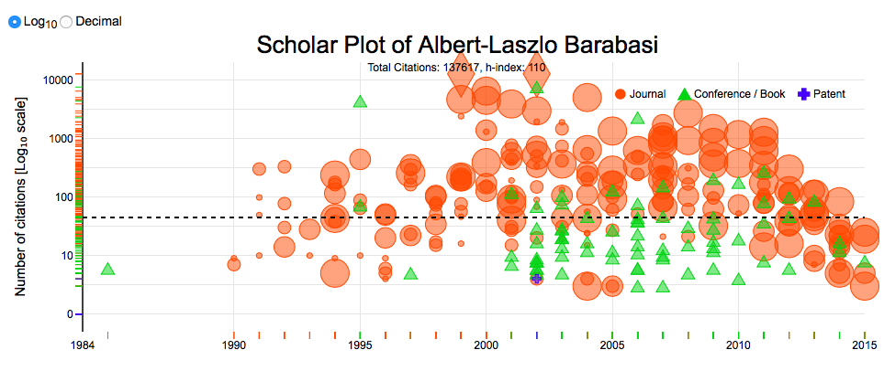
Design and Methodology
Notes:
(Details as much as possible)
This is one result of a scholar who have about 300 publications includes all Journal/ Conference and Patents.
I am sure that most of people includes you understand this visual results tell
It is easy to identify what type of publication powers the individual’s scholarship - a correlate of disciplinary culture. For example, it is easy to spot career profiles of computer scientists and engineers, where typically scholarship is built on conference rather than journal publications.

Slide 20
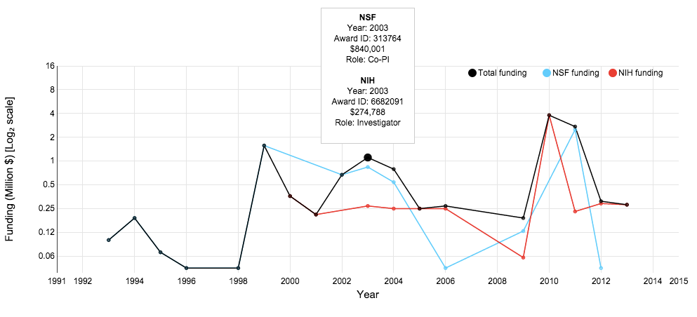
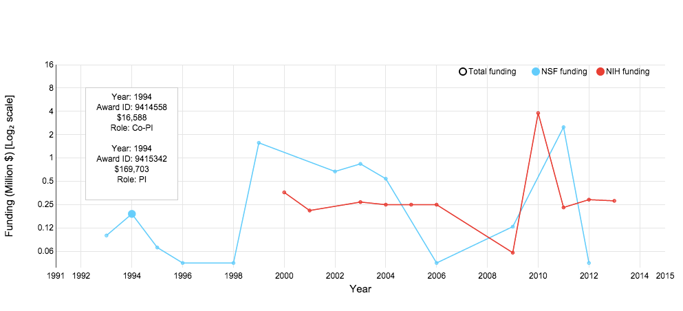
Design and Methodology
Funding results of NSF, NIH, NASA data
Tooltip displays
Agents, Year, Award ID, Amount and Roles such as PI, Co-PI, Investigator
Notes:
In this model, what we found is that citations are explained by the lever of NIH funding.
By the IF of Journal venue where people publish. This is basically solid scientific proof.

Slide 21
Design and Methodology
Feedbacks from social scientist at Northwestern University.
Focus on groups information
Co-authors

Slide 22
Design and Methodology
The 4 panels are consists of
Notes:
forcused survey from norwthwestern
- team size profile /
englieng chosesd

Slide 23
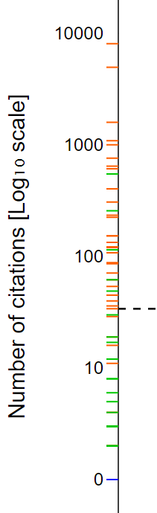
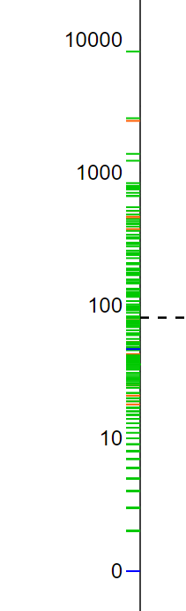
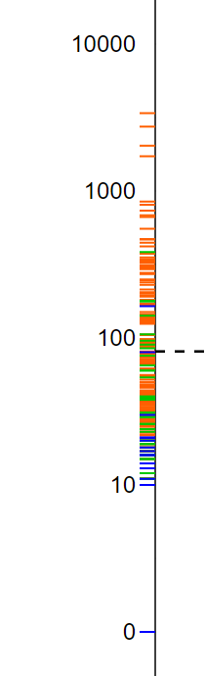
Design and Methodology
Vertical Distribution
A: Some Conference and Journal Papers
B: Focused on Conference Papers
C: Journals and Some Patents
Why this is useful?
You can see and tell their stories briefly.
A
B
C

Slide 24
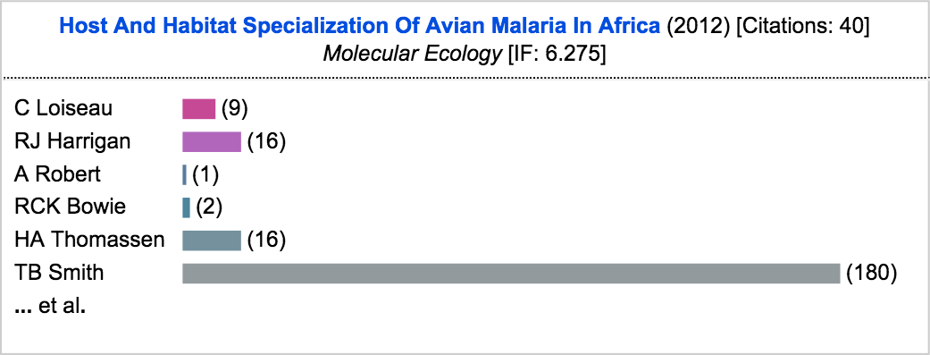
Design and Methodology
Tooltip interacting with details
Title, Year of Publication, Citation number, Journal [Conference, Patent] name and Impact Factor value
Co-Author list by order and the horizontal visual bars to tell how many times each author has been collaborated.
Notes:
We have another feature that interact an each plot.
When you interact with a plot, it shows the tooltip, which includes paper title, year of publication, the number of citations, journal or conference name and journal impact factor.
this is optional

Slide 25
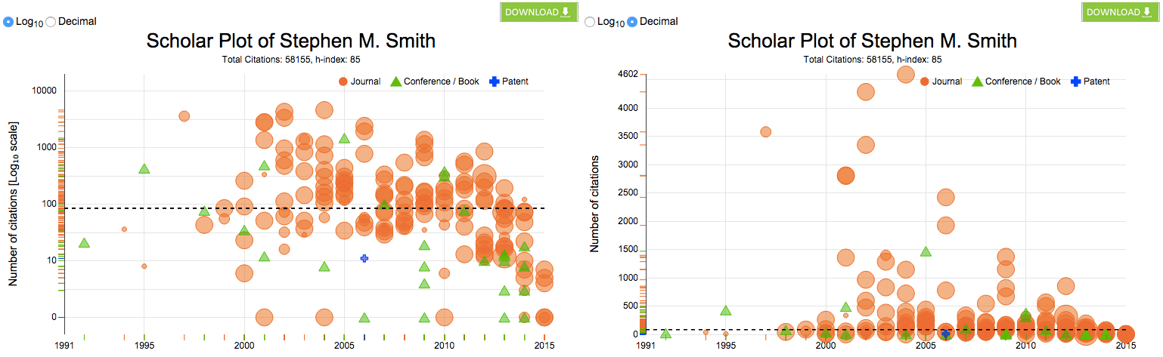
Design and Methodology
Two Different Scale Views
Log₁₀
Decimal
Notes:
Why I did log scales? - good guys
Interaction 1 -

Slide 26
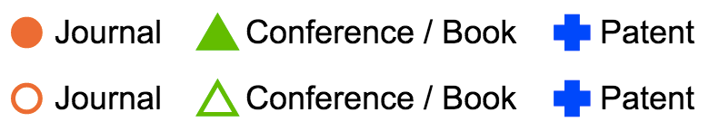
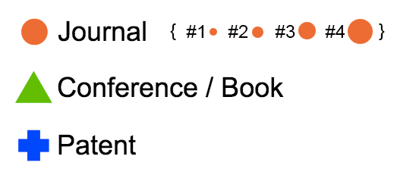
Design and Methodology
Toggle button
Allows to interact the data to show/hide

Slide 27
Demo
Scholar Plot
Notes:
5-8 mins

Slide 28
Data collection methods
Scholar Data
Collection
Clean
Funding and Impact Factor Data
Download, Search
Extract and parse using xmlstarlet
Design RDMBS (MySQL)

Slide 29
Data collection methods
NSF: FY 1985 - FY 2013 (29 years, 312,311 rows, 10,769/year)
NIH: FY 2000 - FY 2013 (14 years, 777,657 rows, 55,456/year)
NASA: FY 2007 - FY 2015 (9 years, 16,670 rows, 1,852/year)
Where to download, How to clean, What to have

Slide 30
Name Disambiguation
Google Scholar includes many different cases on its page of papers
Ioannis T Pavlidis
IT Pavlidis
I Pavlidis
Ioannis Pavlidis

Slide 31
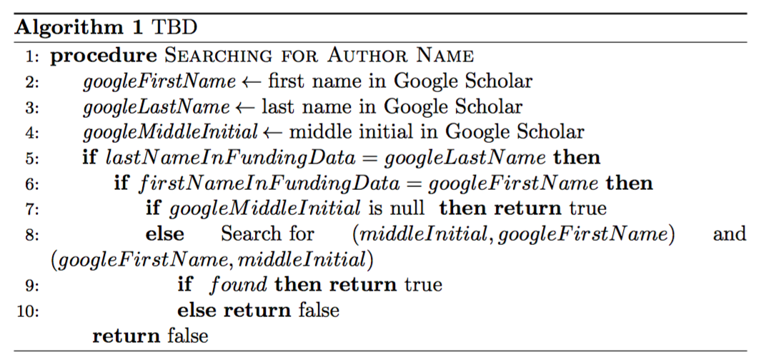
Name Disambiguation
The algorithm applied to the system to match funding data

Slide 32
Scholar Plot System Architecture
Notes:
(30 secs – 1 min)
I do not go through the system. However, I myself want to mention because this system is built very well and took lots of efforts to have it. Frontend Development, MySql Databse, Many Datbase programming, Scrapping information from Google by avoiding blocking. I can’t list all but we even blocked morn than 10 times. We had have ‘sleepless night’

Slide 33
Entity Relationship (ER) Diagrams
Two Different ER diagram
Funding
JCR

Slide 34
Assessment
Method I develop
User assessment
Result assessment
Usage assessment

Slide 35
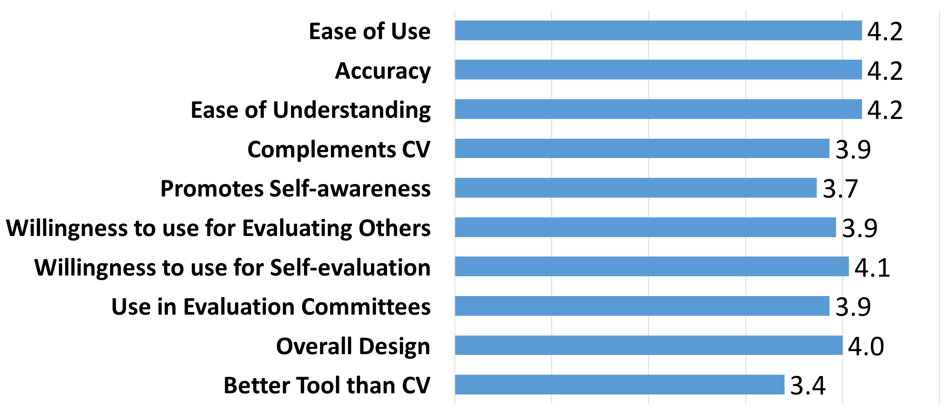
Usability Study
Online Survey
15 participants (Graduate, Post Doc, Professor)

Slide 36
Future Work
Not only individual but also group such as department, college
More agencies if available
Dissertation will be on May 2016 (Expected)
Notes:
We also want to see the group Not only individual but also group such as department, college
JCR Impact Factor update – v.2015 (yearly released)
NSF update – v.2016 (quarterly released)
NIH update – v.2015 (yearly released)
More agencies
More usability survey and refine the product at top-level
What the plan to do
May 2016

Slide 37
PhD Timeline
Fall 2011
Start PhD
Fall 2013
iPhone Scholar Plot
Spring 2016
Core
Fall 2015
CHI Notes
Fall 2012
Started InfoVis
UserPortrait
Started Scholar Plot
Proposal
Graduation
Fall 2014
ACM UbiComp
IEEE VIS
First Publication
GRaSP Poster Presentation
GRaSP Poster Presentation

Slide 38
References
https://cs.stanford.edu/degrees/phd/cs300/jeffrey-heer.pdf

Slide 39
Acknowledgments
Committees
Prof. Ioannis Pavlidis (Computer Science at UH) – Supervisor
Prof. Ricardo Vilalta (Computer Science at UH)
Prof. Zhigang Deng (Computer Science at UH)
Prof. Guoning Chen (Computer Science at UH)
Prof. Brian Uzzi (Northwestern University) – External
All our CPL members

Slide 40
Questions?
Thank you

Slide 41
Departmental Plot

